Slide 1
Operation@Python
4110E237

Slide 2
Agenda
Python Strings
Slicing Strings
Modify Strings
Concatenate Strings
Format Strings
String Methods

Slide 3
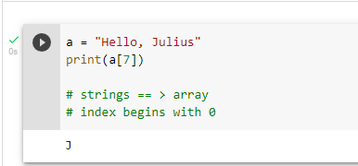
Strings in python are arrays of bytes representing Unicode characters:

Slide 4
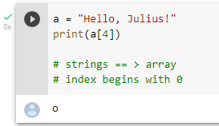
Strings are Arrays ==> access the element of array Python does not have a character data type, a single character is simply a string with a length of 1

Slide 5
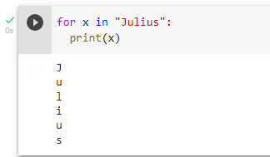
Looping Through a String

Slide 6
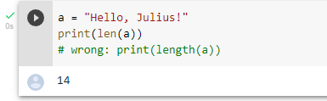
String Length:To get the length of a string, use the len()function

Slide 7
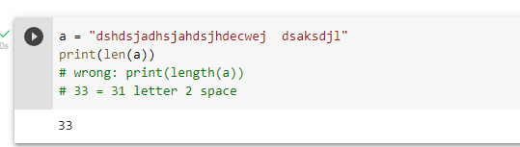
QUIZ: Tell me how many char appear in "dshdsjadhsjahdsjhdecwej dsaksdjl"

Slide 8
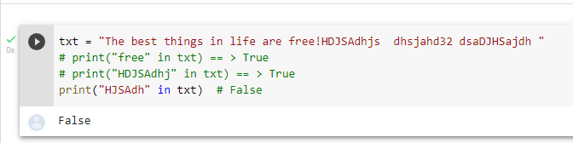
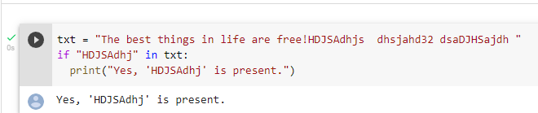
Check String :To check if a certain phrase or character is present in a string, we can use the keyword in.
keyword in vs if
True or False

Slide 9
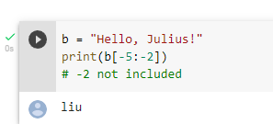
Negative Indexing

Slide 10
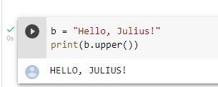
Python - Modify Strings
The upper() method returns the string in upper case:
The lower() method returns the string in lower case

Slide 11
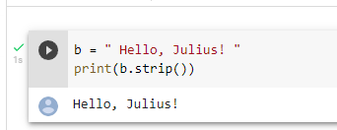
Remove Whitespace with strip() method The strip() method removes any whitespace from the beginning or the end

Slide 12
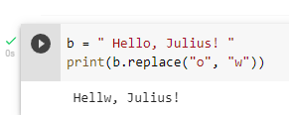
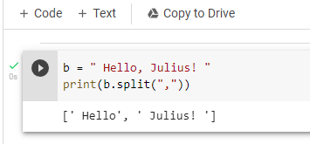
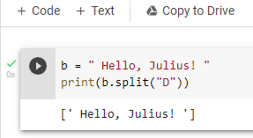
-The replace()method replaces a string with another string -Separator

Slide 13
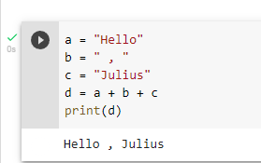
String Concatenation: To concatenate, or combine, two strings you can use the + operator.

Slide 14
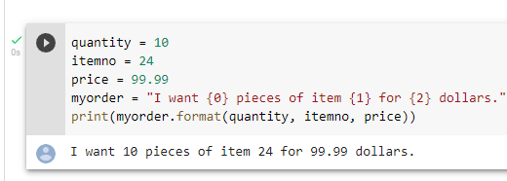
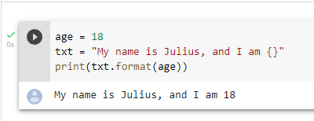
Python - Format - Strings

Slide 15
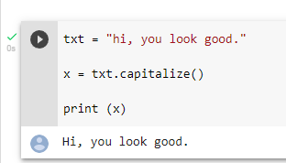
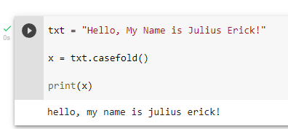
String Methods

Slide 16
STUDY OBJECTIVES
TTT
MARS
VENUS
MERCURY
Mars is actually a very cold place
Venus is the second planet from the Sun
It’s the closest planet to the Sun
SATURN
JUPITER
NEPTUNE
It’s composed of hydrogen and helium
Jupiter is the biggest planet of them all
It’s the farthest planet from the Sun

Slide 17

CHINESE NAME: 朱艾瑞
STUDENT ID: 4110E237
ENGLISH NAME: Saflor, Julius Erick Dela Cuesta
NICKNAME: 0001Player
Email: juliusericksaflor@gmail.com
GITHU: https://github.com/0001Player
THANK YOU!!

